Slide 1
Final Projection Presentation
Presented by Joseph Driscoll and Isaac Hill

Slide 2
Problem
Speed controlled by keypad
Steady state speed within 5% of desired speed
BCD stopwatch that displays times from 0.0 to 9.9 seconds controlled by the keypad
Closed loop response that settles in half the time it takes to settle with an open loop response
Overshoot less than 10%

Slide 3
Solution
We decided to use a PID controller.
The PID controller has three variables that can be altered to control overshoot and response time (?)
[More reasons we chose a PID controller]

Slide 4
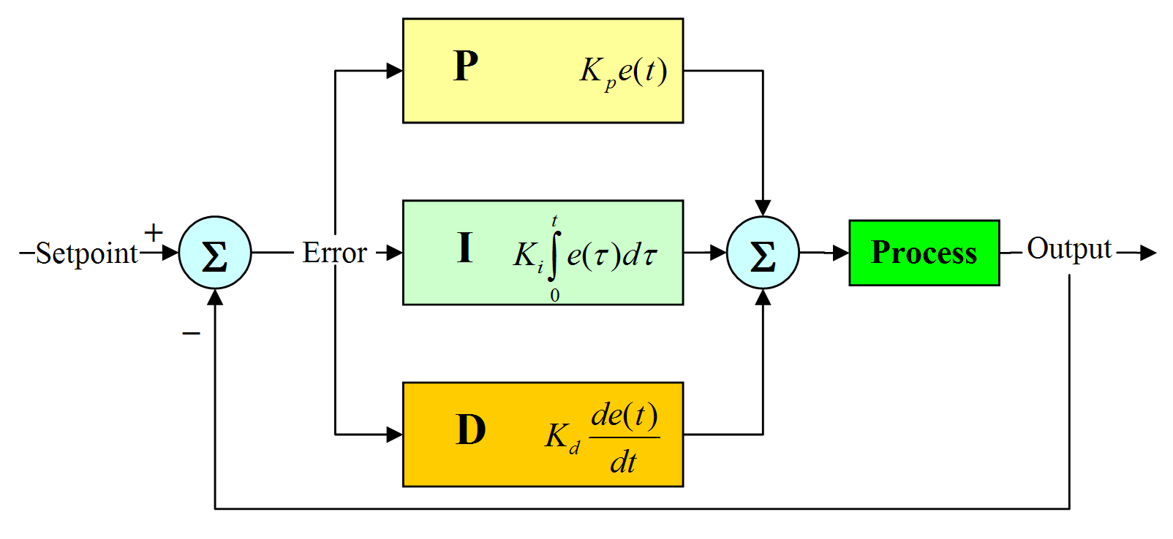
PID Controller
The PID controller has three variables: the proportional gain (K_{p}), the integral gain (K_{i}), and the derivative gain (K_{d}).
https://nicisdigital.wordpress.com/2011/06/27/proportional-integral-derivative-pid-controller/
The PID controller transfer function in the frequency domain is:
C(s) = K_{p} + K_{i}/s + K_{d}*s.

Slide 5
PID Controller Operation
The proportional gain is what causes the controller to respond to different levels of error.
The integral gain lets the controller react to past error values. This eliminates any persistent error that the proportional gain does not correct.
The derivative gain estimates the future error. This constant helps eliminate any error at a faster pace.

Slide 6
MATLAB Graph
Open loop settling time

Slide 7
PID Response
The oscilloscope results below show the response of going from 4 to 8.
Notice how the response time is less than half of the open loop settling time.

Slide 8
PID Program

